Slide 1


Dept. of Comp. Engg.
Welcomes
NBA Team
25th November, 2016

Slide 2

Presentation Outline
Department
Department Introduction
Department Vision, Mission and PEOs
UG Computer Engineering Program
Curriculum
Teaching Learning
Course Outcomes and Program Outcomes
Academic Audit
Student Information
Academic Performance
Student Placement, Higher Studies and Entrepreneurship
Student Activities
Faculty Information
Faculty Training and Workshops
Faculty R&D
Faculty Feedback and Appraisal
Facilities and Technical Support
Student Support Systems
Governance and Institutional Support
Future Plans

Slide 3
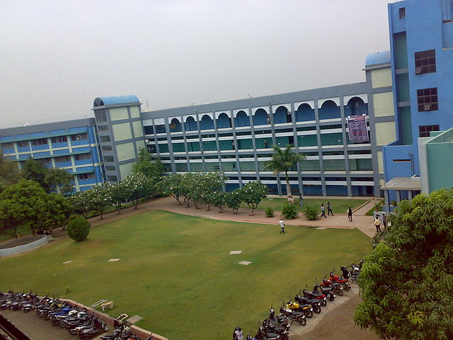
Location of Department
VI
Vishwakarma Institute of Technology

Slide 4

Department at a Glance
VI
Students Intake: Computer Engineering: 90+60 = 150
PG CSE: 25
Current Status : Department Faculty
Ph.D : 08 Professors : 04
Masters : 26 Associate Professors : 02
Faculty pursuing Ph.D : 13 Assistant Professors : 28
UG Computer Engg
Professors : 03
Associate Professors : 01
Assistant Professors : 26
PG CSE
Professors : 01
Associate Professors : 01
Assistant Professors :02
Vishwakarma Institute of Technology
Current Status : Non Teaching
Technical Support : 09 + 01
Class-4 : 07
Notes:
PhDs in the dept: MSP, STP, MLD (Prof. UG), Vivek Deshpande (Prof. PG), Bandewar (Asso. Prof. PG), Gokhale (Asso UG), Joglekar, Ghadekar (Assistant UG)

Slide 5
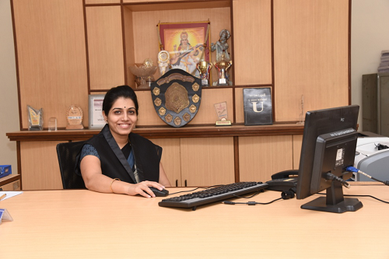
Head of the Department
Prof. Dr. Manasi S. Patwardhan
Educational Background: Masters and Ph.D., Computer Science, University of Tulsa, USA
Experience
With Vishwakarma Institute of Technology from March 2009
Researcher, Knowledge Based Systems Inc, Texas, USA
(July 07 – Oct 08)
Area of Interest: Data Science, Analytics, Machine Learning, Data Mi
Honors
Young Engineers Award, IEI, 2011-12 in the discipline computer Engineering
ACM Grace Hoppers Scholarship from ACM-W and ACM Chapters India.
Allen Chapman Research Scholarship, Feb 2006 and June 2006
Activities
Consultancy work with reputed industries in Pune area
Completed Research Projects: 2 (Sponsored by SPPU, AICTE)
Ongoing Research Projects: 3 (AICTE, DST, Rashtrapati Bhavan)
Shortlisted Research Projects: 2 ( RGSTC, ISRO)
Guiding 6 Ph.D. scholars
Published research papers in reputed International Journals (11) and international conferences (19)
Notes:
Industry consultancy: zensar, algocraft, icertis
Completed research:
“Implementing Articulated Entity Relationship Diagram (AER) for Complete Automation of Relational Database Normalization” Accepted at Board of College and University Development, University of Pune, Amount sanctioned: INR 2 Lac., Grant period: 2010-2012
“Designing a framework for Automation of Educational Data Storage, Accreditation and Prediction (AEDSAP)” Accepted at All India Council for Technical Education (AICTE), India, Amount sanctioned: INR 6.5 Lac., Grant period: 2012-2015
Ongoing Research Projects: 2 (AICTE, DST, Rashtrapati bhavan)
Recognition of facial expression in real time environment for online interactive learning system” Accepted by All India Council for Technical Education (AICTE), India, Budget Sanctioned: INR 7.05 Lac., Grant Period 2014-17
“Patient Scheduling Optimization and Monitoring System for SmartGram”, Presidential Project, Under NSF Center in collaboration with Sunny Binghamton University, NY, USA
“Distributed predictive mental health analytics of netizens using advances in data mining” Accepted by Scheme of Young Scientists and Technologists (SYST), Department of Science and technology (DST) SEED Division. Ref No: SP/YO/060/2016 Amount Asked For: INR 12.56 Lac., Date: 16 June, 2016., Grant Period 2016-18
Shortlisted Research Projects: 2 ( RGSTC
“Gyan Shodh - Knowledge Search Engine in Marathi Language with recognition of printed or handwritten Devanagari script as an input” Submitted to Rajiv Gandhi Science and Technology Commission (RGSTC) cleared 1st stage; accepted for presentation, reference no. RGSTC/PPP-748/2016, Amount Asked For: INR 43.24 Lac.
"An immersive satellite image navigator with human gesture recognition“ , submitted to ISRO-UOP program for Amount Asked for: 14.92 Lacs

Slide 6
Computer Engineering BOS
Sr. No. | Name of Faculty | Nomination
1 | Prof. (Dr.) Manasi S. Patwardhan | Chairman
2 | Prof. S.B. Karthick | Internal Subject Expert
3 | Prof. (Dr.) M.L. Dhore | Internal Subject Expert
4 | Prof. (Dr.) P.S. Joglekar | Internal Subject Expert
5 | Prof. (Dr.) P.K. Gokhale | Internal Subject Expert
6 | Prof. (Dr.) N.S. Chandolikar | Internal Subject Expert
7 | Dr. S.S. Sane | External Subject Expert BOS member, SPPU, Pune
8 | Dr. Vandana Inamdar | Professor Head of Computer Dept, COEP, Pune
9 | Dr. R. Venkateswaran | Industry Representative. Senior Vice President, Persistent Systems Ltd., Pune
10 | Dr. Bernard Menzes | Professor, IIT Powai
11 | Mr. Viraj Kulkarni | Alumnus CTO, CPC Analyst

Slide 7
Departmental Highlights
Impart Training to Industries
Student Internships
WIKI – Department Portal
In-house Software Project Development
Open Source Software
Industry Advisory Board
IIT GPU Nodal Center
SmartGram Presidential Projects
(Under NSF Lab)
IOT Center of Excellence

Slide 8
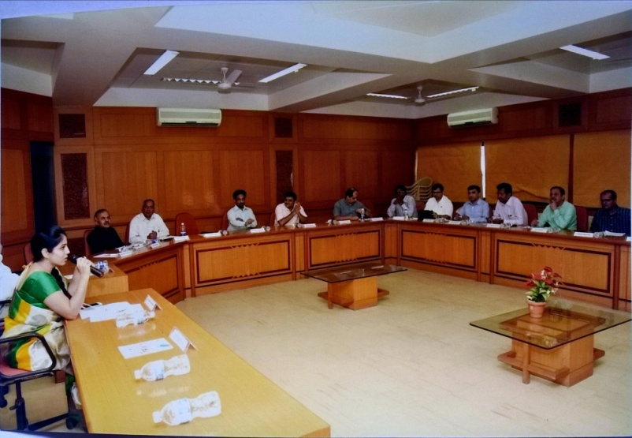
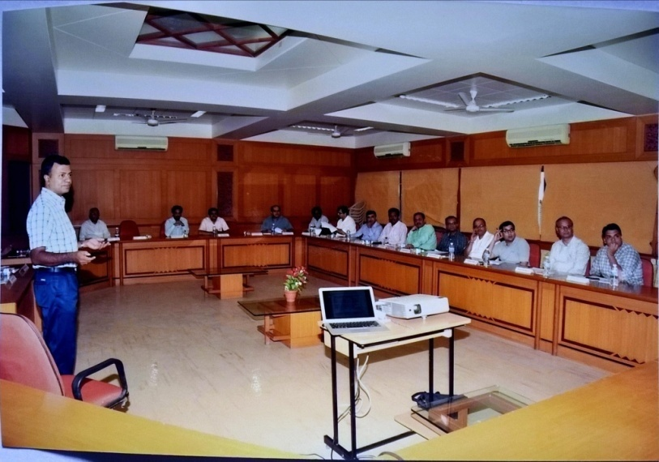
Industry Advisory Board
17 Industry Representatives from HR as well as Technical Background
Industry interaction for
Industry aligned curriculum
Professional Development and Elective courses
Industry visits
Collaborative research projects
Sponsored student projects
Internships
Industry guest lectures
Project competition evaluation and sponsorships
Centre of Excellence
Training for faculty
Increase Employability
Notes:
IOT Centre of Excellence

Slide 9
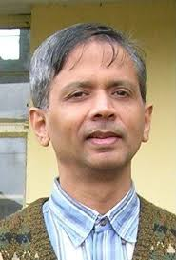
IIT Mentor
Prof. Abhiram Ranade
B.Tech ( Electrical Engineering ) IIT Bombay in 1981
Ph.D (Computer Science) Yale University in 1989
Assistant Professor - Electrical Engineering and Computer Science, University of California, Berkeley, 1988-95
Professor- Computer Science and Engineering, IIT Bombay, from 1995 till date
Role of IIT Mentor
Conducting academic audits to
Suggest curriculum revisions
Improve teaching and learning process
Enhance the quality of assessment process
Faculty training and interaction
Collaborative research
Activities conducted in last 3 years for the Program Development
Academic audit of computer engineering program
Timely Suggestions regarding
Course content revisions
Question papers setting and evaluation
Session conducted on "Enhancing teaching and learning”

Slide 10
Vision, Mission
Program Educational Objectives

Slide 11
Process for defining Vision, Mission and PEO
Institute Vision/Mission
Training inputs
Governing body / Management Requirement
Industry requirement
Faculty Requirement
Department Core committee meetings and brain storming
Student/Parent Requirement
Alumni requirement
Draft copy
Presentation and discussion
in Faculty meetings
Faculty inputs
Refined Draft copy
BOS members input
Presentation in BOS meeting
Copy for approval of ABM
Approval in the Academic Board meeting
Government Bodies
Alumni
Final Copy of Department
Vision and Mission
Website
Industry
Email
Parents
Dissemination to the governing body and other Stake holders through various communication modes
Meetings
Academia
Social Networking Sites

Slide 12
Institute Vision
"To be globally acclaimed Institute in Technical Education and Research for holistic Socio-economic development"
Department Vision
"To be a leader in the world of computing education practicing creativity and innovation"

Slide 13
Department Vision to Mission
"To be a leader in the world of computing education practicing creativity and innovation"
To provide a scholarly environment for the development of computing skills and competencies
To enhance global exposure through academic collaborations
To encourage ethical consciousness in engineers demonstrating sustainable entrepreneurship and professional maturity
To cultivate research culture resulting in knowledge-base and innovative technologies

Slide 14
Institute Mission leads to Department Mission
To impart knowledge and skill based Education in Collaboration with Industry, Academia and Research Organization
To strengthen global collaboration for Students, Faculty Exchange and joint Research
To prepare competent Engineers with the spirit of Entrepreneurship
To Inculcate and Strengthen Research Aptitude amongst the Students and Faculty
To provide a scholarly environment for the development of computing skills and competencies
To enhance global exposure through academic collaborations
To encourage ethical consciousness in engineers demonstrating sustainable entrepreneurship and professional maturity
To cultivate research culture resulting in knowledge-base and innovative technologies

Slide 15
Computer Engineering Program Programme Education Objectives [PEOs]
PEO | PEO Focus | PEO Statement
PEO1 | Preparation | Demonstrate application of sound engineering foundations to be a committed technology workforce
PEO2 | Core competence | Apply mathematical and computing theory knowledge base to provide realistic computer engineering solutions
PEO3 | Breadth | Exhibit problem solving skills and engineering practices to address problems faced by industry with innovative methods, tools and techniques
PEO4 | Professionalism | Adopt professional and ethical practices adopting effective guidelines to acquire desired soft skills in societal and global context
PEO5 | Learning Environment | Aim for continuing education and entrepreneurship in emerging areas of computing

Slide 16
PEO mapping with Department Mission
PEO Statements | M1 | M2 | M3 | M4
PEO1 | 3 |  | 1
PEO2 | 3 |  |  | 2
PEO3 | 1 | 2 |  | 3
PEO4 |  | 3 | 3
PEO5 |  | 1 | 2 | 1
M1: To provide a scholarly environment for the development of computing skills and
competencies
M2: To enhance global exposure through academic collaborations
M3: To encourage ethical consciousness in engineers demonstrating sustainable
entrepreneurship and professional maturity
M4: To cultivate research culture resulting in knowledge-base and innovative
technologies
PEO 1: Demonstrate application of sound engineering foundations to be a committed
technology workforce
PEO 2: Apply mathematical and computing theory knowledge base to provide realistic
computer engineering solutions
PEO 3: Exhibit problem solving skills and engineering practices to address problems
faced by industry with innovative methods, tools and techniques
PEO 4: Adopt professional and ethical practices adopting effective guidelines to acquire
desired soft skills in societal and global context
PEO 5: Aim for continuing education and entrepreneurship in emerging areas of
computing

Slide 17
Program Curriculum

Slide 18
Structure and Curriculum Design
Structure Design
Academic Board
Curriculum Design
Board of Studies
Other Inputs
Curriculum Design and Revision Inputs
ACM Syllabus and ABET Program Specific Criteria
Department faculty and Industry expert
Defined COs and its Non-attainment
Alumni and Students Feedback

Slide 19
Course - Component Distribution
Sr. No. | Course Component | Credits | %
1 | Basic Science | 16 | 8.42
2 | Engineering Science | 25 | 13.16
3 | Humanities and Social Studies | 9 | 4.74
4 | Program Core | 85 | 44.73
5 | Project/Mini Project | 22 | 11.58
6 | Electives | 16 | 8.42
7 | Open Elective | 4 | 2.11
8 | Seminar | 4 | 2.11
9 | CVV,Technical Writing | 9 | 4.74
 | Total Credits | 190 | 100

Slide 20
Courses Mapped to Program Specific Criteria
Computing science
Theory of computation
Software
Systems programming
Parallel computing using GPU
Operating system
Microprocessors and microcontrollers
Systems containing hardware and software components
Embedded systems
Digital signal processing
Computer Organisation
Distributed computing
Cloud computing
Data structures
Computer graphics
Design Analysis of Algorithms
Object Oriented Modeling and Design
Software Engineering
Discrete Mathematics
Discrete structures and graph theory
Differential and integral calculus
Mathematical transformations and applications
Linear Algebra and Random Variables
Probability and statistics
Business intelligence and analytics

Slide 21
Technical Domains
Advance Mathematics | Professional Core | Computing |  | Modeling | Programming | Application |  | Professional Abilities and Soft Skills
Discrete Structures and Graph theory | Data Structures | Computer Programming | Computer Graphics | Software Engineering | PHP MYSQL | Business Intelligence and Analytics | Mobile Application Development | Mini Project
Mathematical Transformations and Applications | Computer Organization | Problem Solving and Programming | Microprocessors and Microcontrollers | Database Management Systems | C#.NET | Product Design | Ethical Hacking and Network Defense | Comprehensive Viva Voce
Algorithmic Number Theory and Algebra | Digital Electronics and Logic Design | PIC Microcontroller | Advanced Data Structures | Object Oriented Modeling and Design | Python | Human Computer Interaction | Geographical Information Systems | Project Stage - 1
Randomized and Approximation Algorithms | Data Communication | Big Data Technologies | Distributed Computing | Enterprise Systems | ASP.NET | Software testing and Quality Assurance | Management Information Systems | Seminar
 | Microprocessor and Interfacing | Machine Learning | Digital Signal Processing | Advanced Computer Graphics | Advanced Java | Convergence Technologies | Network Security | Project Stage - II
 | Operating Systems | Information Retrieval | Embedded Systems | Modeling and Simulation | Spring Framework | Data Mining |  | Project Stage - III
 | Computer Networks |  | Compiler Design |  | Struts Framework |  |  | Technical Writing
 | Theory of Computation |  | Mobile Computing |  | Matlab |  |  | General Seminar - 2
 | Design and Analysis of Algorithm |  | Cloud Computing |  | Principles of Programming Languages
 | Systems Programming |  | Neural Networks
 | Advanced Computer Architecture |  | Image Processing
 |  |  | Parallel Computing on GPU
 |  |  | Artificial Intelligence

Slide 22
Teaching Learning
And Assessment

Slide 23
Teaching Learning Process and Improvement
EFFICIENT TEACHING FORCE
1. Course Delivery
2.Student
Feedback
3. Faculty Appraisal
4. Faculty Training and MOOC
Academic Calendar
As per UGC guidelines
Execution
Lectures, Practicals
Quality Checks
Periodic evaluation and assessment
Expert Lectures
ISO standards
Internships
Projects
Encourage Bright Students:
Challenging Assignments
Challenging Questions in exams
Extra Projects
Internships
Support Weak Students:
Re-test
Remedial
teaching
Counseling
Re-registration

Slide 24
Assessment Mechanism
Project Assessment
Project Initiation
Mini Project
Internship
Evaluation
Internal faculty
Industry Experts for final review
Competition
Major Project
Project Allocation
Domain Interests of Students
Faculty Expertise
Twice a semester
Sponsored/ In-house projects
Individual and Team performance
PRAKALP and NAVONMESH
Evaluation of project by industry experts
Working prototypes / Publications
Project Commercialization

Slide 25
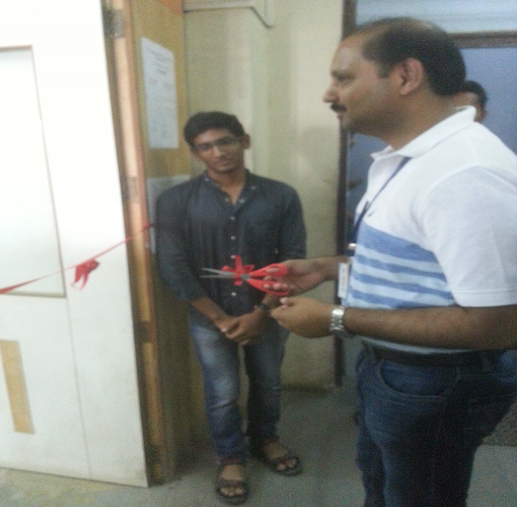
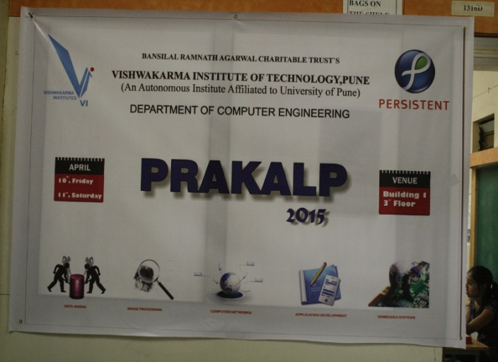
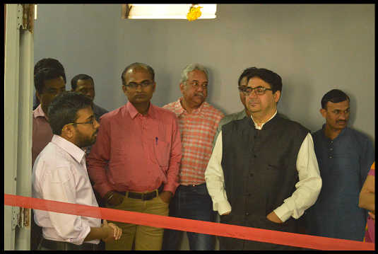
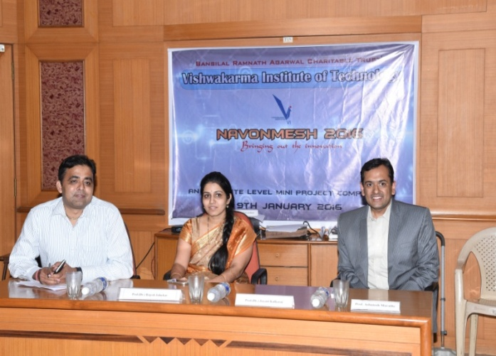
Project Competitions
Judged by the panel consisting of faculty and industry experts
Project Evaluation Criteria:
Social Relevance
Business Potential
Innovation
Development Quality
Prakalp 2014
Prakalp 2015
Prakalp 2016
Navonmesh 2016
Industry Sponsored Event
Notes:
B.Tech. final year major project competition held every year
To encourage students for developing excellent projects
Initially shortlisted based on internal guide feedback and then
presented in exhibition under 3-4 domains.
Judged by the panel consisting of faculty and industry experts.
This event is jointly sponsored by VIT and an industry sponsor
(e.g. Calsoft (2016) and PSPL (2015))
Prakalp 2015 Statistics:
70 groups
30 industry experts
Total of 453 evaluations (143 external + 310 internal)
Average 7 evaluations / project

Slide 26
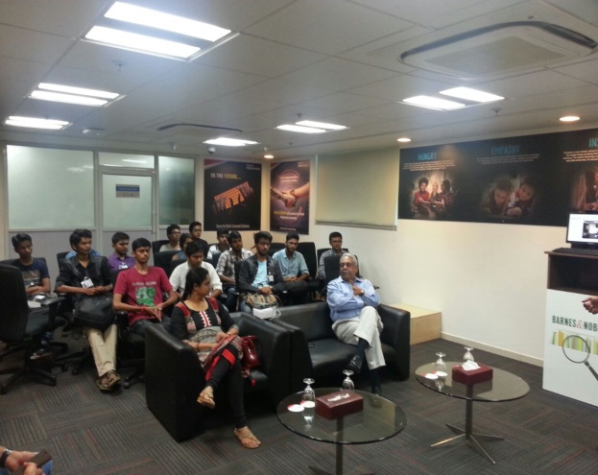
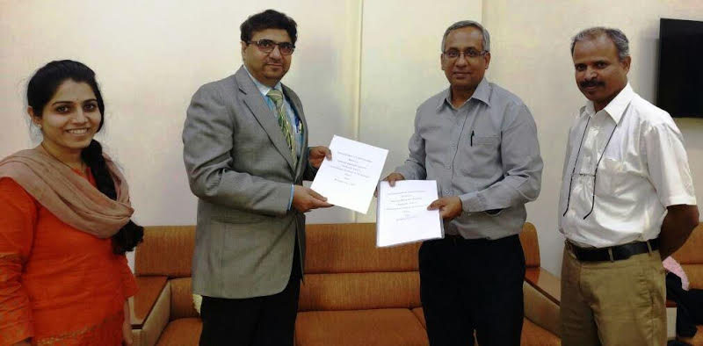
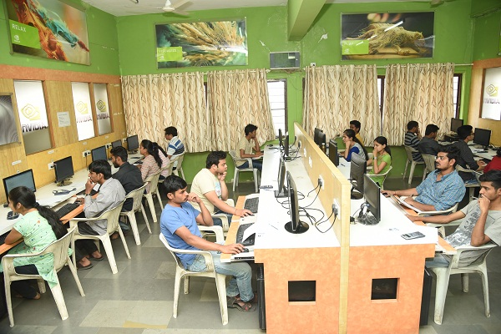
Industry Contribution for Teaching Learning
IAB Meeting
Presented Curriculum
Suggestions Incorporated
Help in Placement and Higher Studies
Curriculum Revision
Lab Development
Project Evaluations
Internships
Industry Visits
PD courses and Electives by industry
nVIDIA Lab
GPU Computing based projects
IIT Nodal Center
Research Grants
Industry/ Academia Training
Industrial Visit to Tech Mahindra
Sponsored Lab: nVIDIA
IOT Center Of Excellence

Slide 27



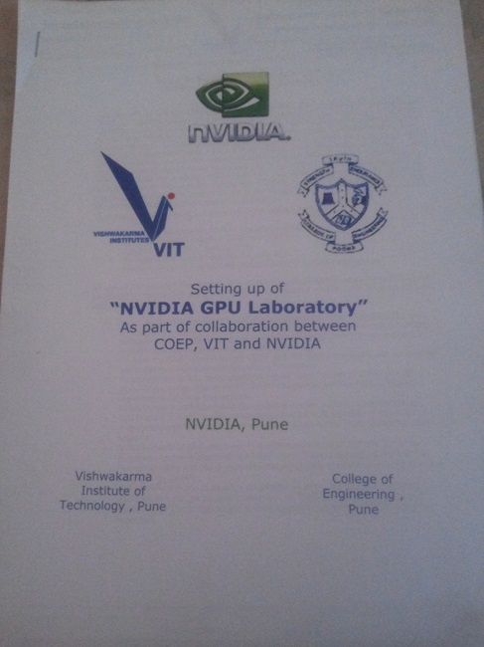
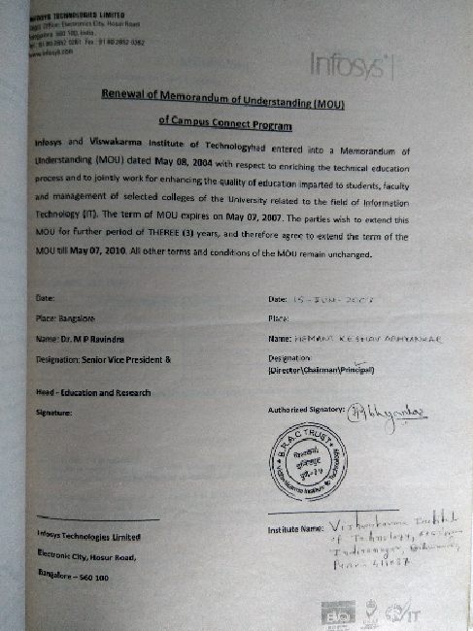
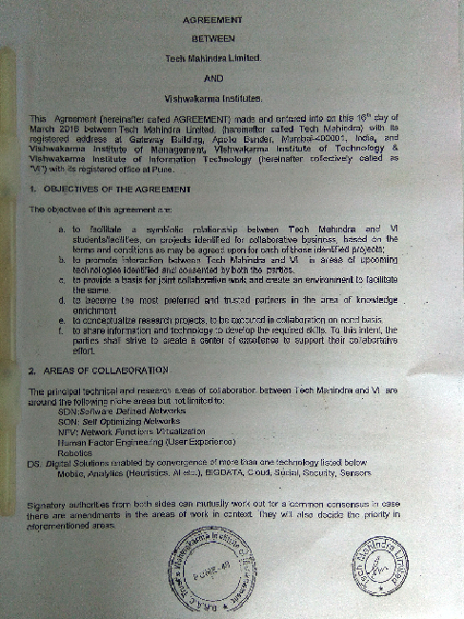

Industy MOUs

Slide 28






Initiatives related to Industry Internship
Academic Calendar
Provision for semester long and summer internship in academic calendar
Liaisons
Liaisons with Industries
Evaluation
Twice a semester
Opportunity for Internships
Impact
Improvement in Placements
Project Commercialization
Six months /summer internships in Industry
Mentor Feedback
Paper Publication
Stipends up to Rs. 66,000
Companies approached for 2016-17 Sem 2: Ubisoft, NVIDIA, Tech Mahindra, VMWare

Slide 29



Professional Courses Conducted by Industries
Sr No | Name of adjunct/ visiting faculty | Background | Course Taught | Type of Course (Theory, Elective PD) | Year
2013-14
1 | Girish Bharambe | NVIDIA, Pune | Problem solving | PD | TY
2 | Anup Bhatkar | Enlighted Inc, Pune, India | Machine Learning | Core Theory | B.Tech
2014-15
3 | Girish Bharambe, Pavan Mahalle | NVIDIA | Problem solving | PD | TY
4 | Nikhil Bhagwat | TCS | Ethical Hacking & Network Defence | PD | TY
5 | Prashant Kaushal | KonSoftech-Own Startup | Advanced Java | PD | TY
6 | Anuradha L. and Rustam Mody | Persistent | Python Programming | SD | SY

Slide 30

Professional Courses Conducted by Industries
Sr No | Name of adjunct/ visiting faculty | Background | Course Taught | Type of Course (Theory, Elective PD) | Year
2015-16
7 | Girish Bharambe, Pavan Mahalle | NVIDIA, Pune | Problem solving and programming | PD | TY
8 | Nikhil Bhagwat | TCS | Ethical Hacking and Network Defence | PD | TY
9 | Kedar Dixit | PSL | Big data technologies | PD | TY
10 | Prashant Kaushal | KonSoftech-Own Startup | Cloud computing | Elective + Lab | B.Tech
2016-17
11 | Prashant Kaushal | KonSoftech-Own Startup | Advance Java | PD | TY
12 | Kedar Dixit | PSL | Big data technologies | PD | TY
13 | Bhushan Garware | PSL | Machine Learning | Elective + Lab | B.Tech

Slide 31
Course Outcomes and Program Outcomes

Slide 32
COs, POs and PSOs
12- POs
4 - PSOs
Faculty Credentials and
Research Projects.
6 - COs
5 - COs
1 - CO
Attainment Level 1-5
Co-relation strengths from 1-3
HAs, CTs, MSE
(In-Sem), ESE (End-Sem) and Lab Assignment question
Mini/ Major Projects, Seminars,
Industry Internships majorly mapped to PO7-PO12
CO Attainment for academic year 2015-16
Curriculum
 | SEM-I | SEM-II | Overall
Total No. of COs Defined | 423 | 410 | 455
Total Number of Attained COs. | 353 | 367 | 391
Number of Non-Attained COs. | 70 | 43 | 64
Percentage of CO Attainment. | 83.45% | 89.51% | 85.93%
PO Attainment Logic

Slide 33
PO Attainment
Direct attainment:- Through CO-PO mapping and attainment of COs. (Students Performance)
In-Direct attainment:- Through surveys (Alumni, Employer, Students Exit survey). (Using Questionnaires)
Overall PO attainment= 0.8 (Direct attainment)+ 0.2 (In-Direct attainment)
PO/PSO | PO1 | PO2 | PO3 | PO4 | PO5 | PO6 | PO7 | PO8 | PO9 | PO10 | PO11 | PO12 | PSO1 | PSO2 | PSO3 | PSO4
0.8* Direct attainment | 78.26 | 71.70 | 69.63 | 71.52 | 64.54 | 76.28 | 74.55 | 75.90 | 73.85 | 71.88 | 72.00 | 69.63 | 56.47 | 72.50 | 63.78 | 62.86
0.2* Indirect attainment | 15.14 | 14.26 | 13.92 | 15.20 | 14.74 | 14.02 | 14.36 | 14.56 | 15.26 | 14.90 | 14.10 | 15.20 | 14.84 | 14.54 | 13.56 | 13.92
Final % attainment | 93.40 | 85.96 | 83.55 | 86.72 | 79.28 | 90.30 | 88.91 | 90.46 | 89.11 | 86.78 | 86.10 | 84.83 | 71.31 | 87.04 | 77.34 | 76.78
PO/PSO Attained (Yes/No) | Yes | Yes | Yes | Yes | Yes | Yes | Yes | Yes | Yes | Yes | Yes | Yes | Yes | Yes | Yes | Yes
66% Threshold

Slide 34
PO Improvement Over Semesters of Academic Year 2015-16

Slide 35
Improvement Through CO Non-Attainment
CO Attainment
Attainment in Sem 1 of Academic Year 2015-16
Corrective Action taken in Sem 2 of Academic Year 2015-16
Corrective Actions Taken in the areas of :
Pedagogy/ Teaching Methodology (Reflected in Course Plan)
Assessment Tools (Reflected in Question asked in HAs, CTs and ESEs)
Course Topics (Will be reflected in revised curriculum in Academic year 2017-18)
Contact Hours (Will be reflected in revised structure in Academic year 2017-18)
Prerequisite / Bridge Courses (Will be reflected in revised structure in Academic year 2017-18)
CO Attained?
No
Yes
Attainment in Sem 2 of Academic Year 2015-16
Corrective Action taken in Sem 1 of Academic Year 2016-17
CO Attained?
No
Yes
Level may increased after
another year of assessment
if the trend persist
………..

Slide 36
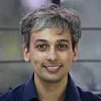
Academic Audit
Conducted on 18th April 2016 for AY 2015-16.
Off site audit
Course Content
Photo-copy of the Answer Sheets
Question papers
Dr. Abhiram Ranade (IIT Bombay)
Mr. Udyan Kanade (CEO, Onerix Lab)
In-campus audit
Teaching Learning
Assessment: HA, CT, MSE and ESE
Projects: Mini, Major
Faculty and Student Interaction

Slide 37
Academic Audit Feedback and Corrective Actions
Syllabus and
Course Content
Auditor’s Comment : Have suggested changes in some courses. For eg in TOC course we need to have some programming assignments based on HMM and transliteration to drive home points related to Automata theory.
Course Delivery
Assessment
Auditor’s Comment: Descriptive questions should be kept as minimal as possible and numerical or problems should be asked by providing more applied/ real life examples.
These comments have been considered while setting question papers in AY 2016-17
Auditor’s Comment: It is extremely necessary to have good, detailed motivational examples in the beginning.
Action planned: Course Plan now reflects more practical Examples to sufficiently motivate the students
The next curriculum revision from AY 2017-18 shall address these comments.

Slide 38
Student Performance

Slide 39
Student Enrollment Ratio
Average Enrolment Ratio: 98.89%

Slide 40
Admission for Computer Engineering
Student Ranks
Out of total 1 Lac students taking admission engineering.
Top 3% students take admission in the program

Slide 41
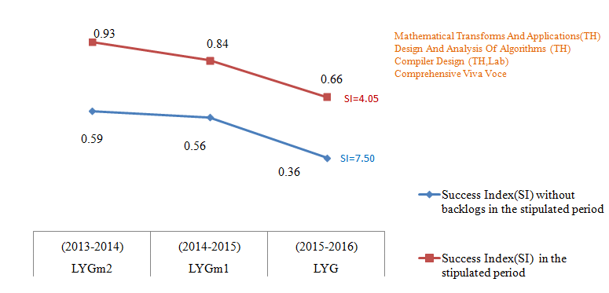
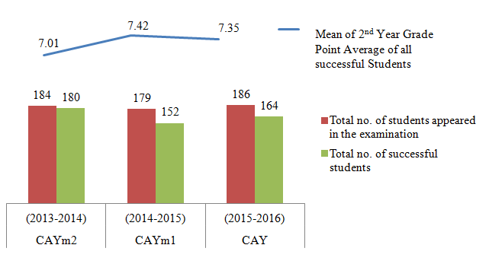
Result Analysis
Success Rate of Graduated Students
Academic Performance in Second Year

Slide 42













Plan of Action for Improvement
Admissions
Academic Performance
Weak Students

Slide 43


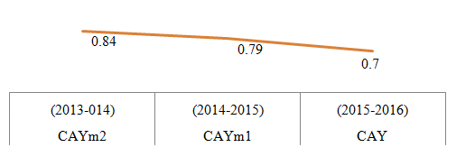














Placement
Academic Year | Highest Salary (in lacs) | Company Name | Students
2016-17 | 16.17 | Morgan Stanley | Nikhil Supekar
2015-16 | 13.00 | Goldman Sachs | Abhishek Dayama Doshi Rohan R. Patel Monika
2014-15 | 10.50 | Nvidia | Sonawane Bhushan
2013-14 | 11.60 | Morgan Stanley | Savitrusuryanarayan Suryawanshi Kalyani

Slide 44











Higher Studies
Master of Science (M.S.),
-Computer Science
Information Systems
Management Information Systems
Computer Systems Networking and Telecommunications
Master of Business Administration (MBA)

Slide 45
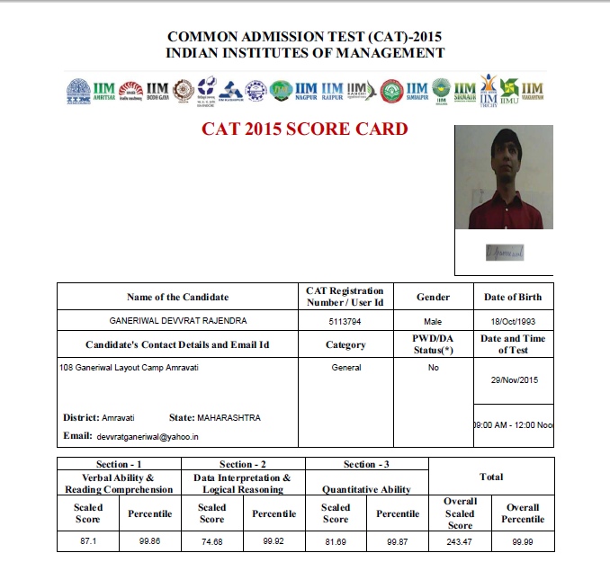


Highest CAT Scorer
Devvrat Ganeriwal : 99.99 percentile
BTech – Comp 2015 batch.

Slide 46

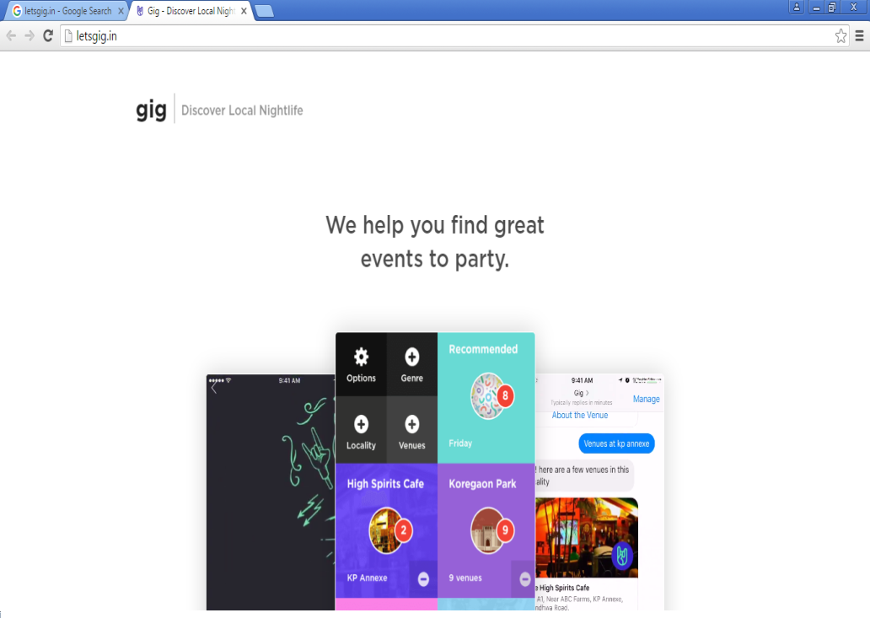
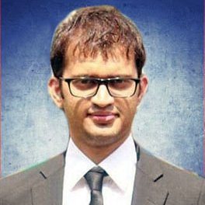
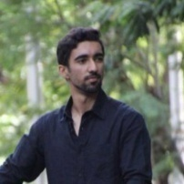
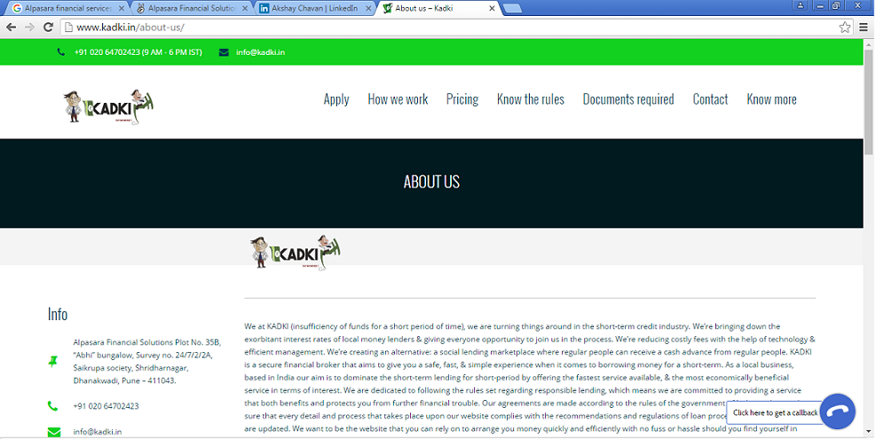
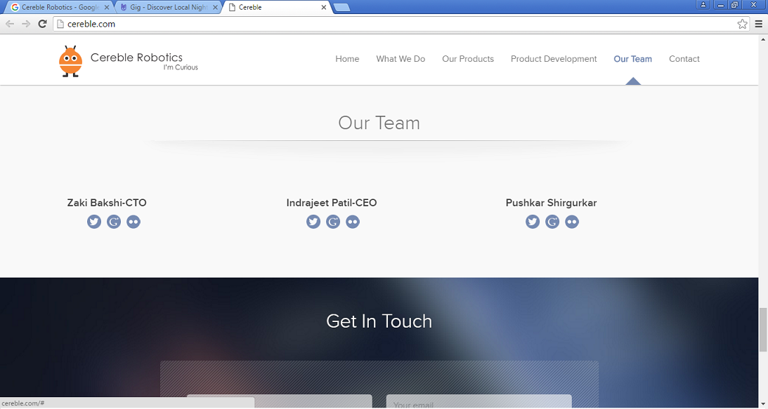
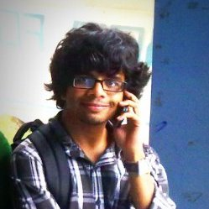
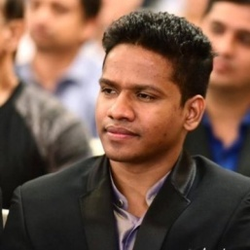
Entrepreneurship
Siddhart Dashore
Bilal Chaglani
Academic Year | Name of student | Company/Startup
2015-16 | Siddhart Dashore | Founder/CEO Friendz Designers & Developers www. friendzdnd.com
 | Rushad Daruwala | Proprietor at Crescent Roots Crescent Group Of Companies
 | Avinash Ahuja Akash Talele | Founder www.magicways.in
2014-15 | Ajit Patil | Punder Epoch360 www.epoch360.strikingly.com
 | Bilal Chaglani | Founder & CEO at letsgig.in www.letsgig.in
 | Akshay Chavan | Alpasara financial services (Kadki) www.kadki.in
 | Prasen Shelar | CEO at OFY R & D PVT. LTD. www.toflier.in
 | Gaurav Shegaonkar | Co-Founder | OFY R&D Pvt. Ltd. www.toflier.in
2013-14 | Indraneel Patil | Founder & CEO at Cereble Robotics www.cereble.com
Ajit Patil:www.epoch360.strikingly.com
Indraneel Patil
Akshay Chavan

Slide 47
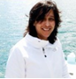
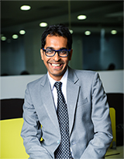
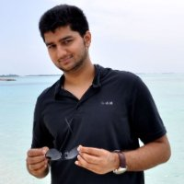
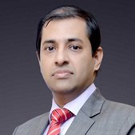
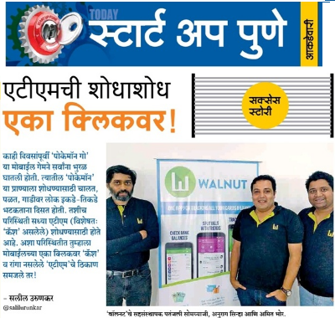
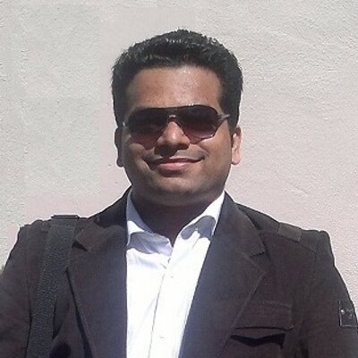
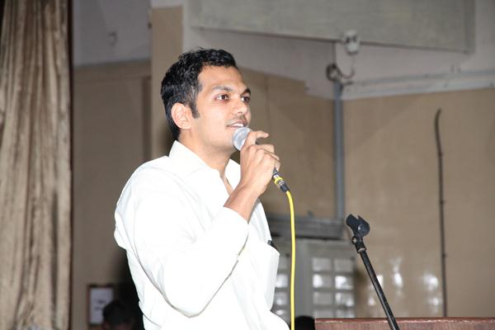
Meritorious Alumni
Nilesh Bafna
Viraj Kulkarni
Anuja Gogte
Entrepreneur and Computer Scientist
Preetam Parwatkar
SVP & Global Head of Strategic Relationships & Alliances
Engineering Manager
CTO, Perennial Systems
Mobile Apps at Citrix
Tech Mahindra,Pune
Anvit Phatak
Rohan R Vibhandik
Director
Research Scientist - Cyber Intelligence
Millennium National School, Pune

Slide 48






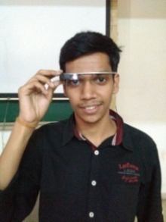
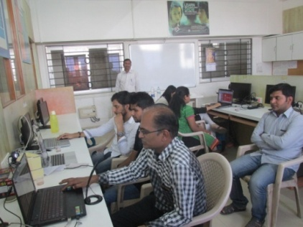
Professional Activities
Professional societies/ chapters | ACM | IEEE
2015-16 | 14 | 13
2014-15 | 10 | 11
2013-14 | 13 | 16
Product Demo
- ACM ICPC
- Google Code Jam
- Facebook Hacker Cup
- HackerRank
- CodeChef
- ProjectEuler
- InterviewStreet (HackerRankX)
1.Group of Competitive Coders (GCC)
2. Programmers’ Hub Fresher
Interactive Training Session

Slide 49
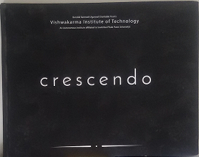



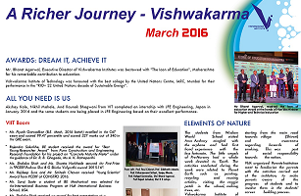
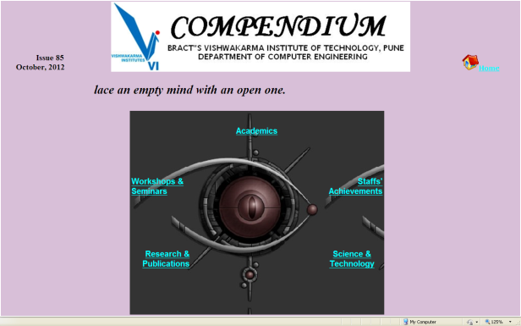
Technical Magazines and Newsletters
2016 Edition
2015 Edition
2014 Edition
wiki
Newsletter
E-bulletin

Slide 50
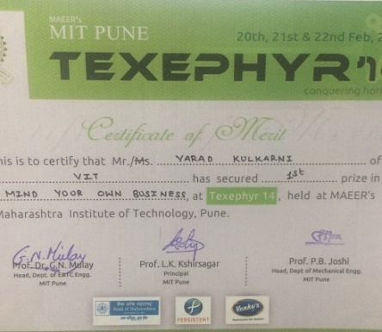

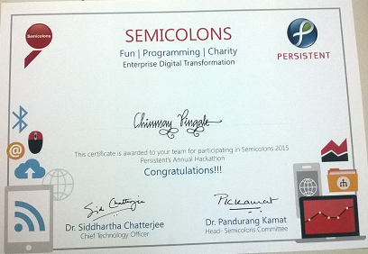
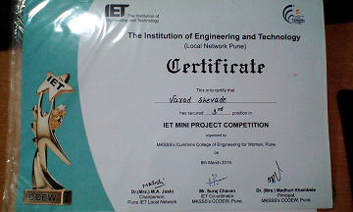
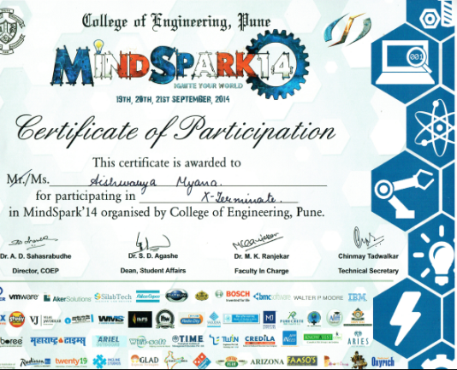
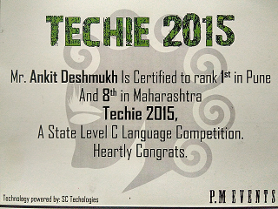
Participation in Inter-Institute Events
 | State Level | National / International Level | Prizes/ Awards
2015-16 | 2 | 16 | 9
2014-15 | 7 | 12 | 9
2013-14 | 5 | 7 | 8

Slide 51
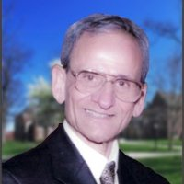
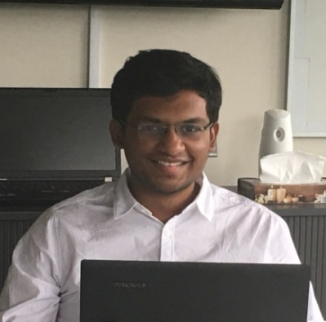
Academic Collaborations: Global Exposure
Exchange program to OMG – Canada
Academic Year | Name of student | University Name
2015-16 | Akash Shah | Ryerson University
2014-15 | Tarun Abichandani
 | Pratik Kabara
 | Anuj Doiphode
2012-13 | Nisarg Patel | University of Toronto
 | Mayuri Sethiya | Queen's University, Kingston, Canada
Prof. Onkar Sharma
Pranav Sanjay Katariya
Achievement
Techno-Commercial Business Development internship at Lavaris Technologies, Germany
August 1st to August 28th 2016.
Business Visa
Research on the Indian Market and Sentimental Analysis of the end user

Slide 52
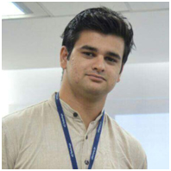
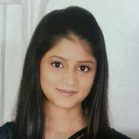
Best Outgoing Student
Faculty nominations and self-nominations from students
[CPI>=8.25 without backlog and
co-curricular and extra-curricular activities ]
JITENDRA SAVANUR
2014-2015
MILONI MEHTA
2015-2016
Departmental committee shortlist 3 candidates
Judge students based upon their communication skills, intellect, wit, maturity and depth of answers
Director, Deans, HODs
30 minutes interview
Institute level interview to decide Best outgoing student

Slide 53


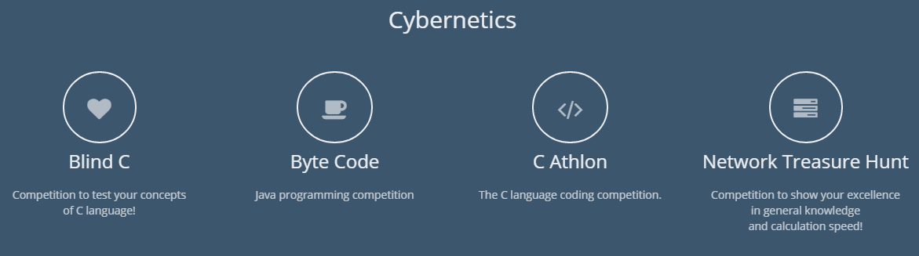
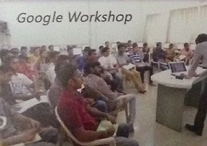

Technical Events Organized

Slide 54
Guest Lectures
Prof Ganesh Ramakrishnan, IIT Bombay
WEB MINING and Information Extraction
8-8-13
Kanika Nema, VMware
Server Virtualization
25-9-13
Mr. Amol Solanki, Synechron Technology
Implementation aspects of cloud Computing
28-09-13
Snehkumar Shahani, Persistant
Agile Methodology
16-4-2015
Satyen Parikh,Managing Director (SAARC),Borland Software India Pvt. Ltd.
How to prepare for a Career
11-3-15
Dr Abhiram Rande, IIT Bombay
Challenges & Difficulties in Teaching DS, Algorithms and programming languages
25-5-2015
Mr. Gaurav Taywade,Technical Lead, OAB studios
'Google Glass' and Mobile Apps
12-4-14
Girish Keshav Palshikar, TRDDC
Relation Mining and Named Entity Recognition
6-2-15
Dr. Neelesh Kumbhojkar (Cloud Computing Head,TechMahindra)
Cloud Computing Domain and various innovations happening in TechManhindra
7-4-2016
Mr. Yogesh Baber ,Redhat
25-2-2016
Redhat Linux OS

Slide 55
Faculty Information

Slide 56

Student-Faculty Ratio (SFR)
Year | Student Intake (X) | Total No of students (N) | Faculty (F) | SFR
2015-16 | 180 | 540 | 37 | 14.61
2014-15 | 180 | 540 | 36 | 14.98
2013-14 | 180 | 540 | 34 | 15.84
Average SFR for three assessment years |  |  |  | 15.14
SFR ratio = N/F
F = (Regular Full time Faculty of UG Computer Engg Program + Fractional load of faculty shared from other programs – Fractional load of Computer Engg UG program faculty shared to other programs)
These calculations are done without considering visiting faculty from industry
56
56

Slide 57
Faculty Cadre Proportion
96.67% Faculty of CAY-2 Retained for 3 assessment years
Faculty Qualification

Slide 58
Faculty Qualification
X = no. of regular faculty with Ph.D.
Y = no. of regular faculty with M. Tech.
F = no. of regular faculty required to comply 1:15 Faculty
student ratio
YEAR | X | Y | F | FQ
2015-16 | 7 | 25 | 36 | 12.2
2014-15 | 5 | 25 | 36 | 11.11
2013-14 | 4 | 26 | 36 | 10.89
Average Assessment |  |  |  | 11.4

Slide 59

Adjunct/ Visiting Faculty
Dr. Vinay Vaidya
Formerly working with Boeing, USA, At Research Position
Girish Bharambe
NVIDIA
Sub: Problem solving
Pavan Mahalle
NVIDIA
Sub: Problem solving
VMS consultants
Prashant Kaushal
KonSoftech
Sub: Adv. Java, Cloud Computing
7+2 Hrs per week
2 Hrs per week
2 Hrs per week
1 Day in a week
Kedar Dixit
PSPL
Sub: Big data technologies
Anup Bhatkar
Enlighted Inc
Sub:Machine Learning
Nikhil Bhagwat
TCS
Sub: Ethical Hacking and Network Defence
Bhashan Garware
PSPL
Sub: Machine Learning
4 Hrs per week
3 Hrs per week
4 Hrs per week
3 Hrs per week

Slide 60
Faculty Competencies in Correlation with Program Specific Criteria
 | H/W S/W Components | Computing Science | Software | Probability & Statistics
Prof. Dr.M.S.Patwardhan |  |  | Data Mining | Data Analytics
Prof. Dr. M.L.Dhore | Computer Networks | Mobile Computing | Internet Routing Algorithms
Prof. Dr. P.K.Gokhale | Computer Network | Cloud / Mobile Computing | Advanced Data Structure
Prof. Dr. S.T.Patil | Computer Organisation, ACA |  | Machine Learning
Mr. N.Z. Tarapore | Network Security |  | Machine Learning
Mr. M.V. Kulkarni |  |  | Data Structures, Artificial Intelligence
Mr. S.R. Shinde | Networks, Optical Communication, Network Security
Dr. P.P. Ghadekar | Microprocessor Interfacings, Digital Electronics |  | Image Processing

Slide 61




Innovations in Teaching and Learning
Faculty upload course material on Departmental Wiki Portal and Assignment Portal
Major Project
Course Material
Mini Project
Seminar

Slide 62
Innovations in Teaching and Learning
Innovative Teaching Learning
Group Discussion
Role Playing
Chorus
Response
Think Break
Problem Solving
Case Studies
Quiz
Analogies

Slide 63
Faculty Training and Workshops

Slide 64










Conferences Organized
IEEE Conference on Information Processing December’ 2015
National Conference on Modeling Optimization and Control March’ 2015

Slide 65










Faculty Training Conducted
GPA 2014_IIT Bombay | Infosys Campus Connect | Intuitive Data Analytics, Zensar Technology
Raspberry Pi Development | Mathematical Modeling FDP | CUDA workshop organized, Trichi
Android APP Work | GPU Computing 2016 | Implementation of IOT & Image Processing

Slide 66
Faculty Training Attended
Training Conducted
2013-14 | 2014-15 | 2015-16
1 | 1 | 5
ISTE sponsored by MHRD & organized by IITs
2014-15: (Cyber security, Introduction to Design of Algorithms)
2015-16: (Technical Communication)
Organized by ACM
2013-14 : (Text Mining Workshop)
3 faculties participated
2014-15: (Mathematical Modeling)
Induction Training Program By NITTTR, Bhopal
2013-14 :(Computer programming, Computer Networking)
Attended by 9 faculties
7 faculties participated
4 faculties participated
3 faculties participated
8 faculties participated
Training Attended for more than 2 days
2013-14 | 2014-15 | 2015-16
31 | 21 | 29
Training Attended for more than 1week STTP
2013-14 | 2014-15 | 2015-16
7 | 17 | 4
Training Attended for more than 2 weeks STTP
2013-14 | 2014-15 | 2015-16
12 | 5 | 10

Slide 67
Faculty Research
And Development

Slide 68



Faculty Research

Slide 69

Faculty PhD Status
Ph.D Completed
Ph.D Guides
Prof. P .K. Gokhale
IIT Bombay
2015
Prof. P. P. Ghadekar
Amravati University
2016
Prof. S .T . Patil
Guiding 7 research scholars
Prof. M . S . Patwardhan
Guiding 5 research scholars
Prof . M. L. Dhore
Guiding 1 research scholar
Other Ph.D. in Department
Number of Faculty pursuing
Ph.D. in the Department:
13
Dr.P.S.Joglekar
Dr.V.S.Deshpande
Dr. S.R.Bandewar
Dr.Vinay Vaidya

Slide 70
Quality Publications
6 Papers
35 Papers
3 Papers
3 Papers
9 Papers
4 Papers
13
11
8
8
7

Slide 71
Sponsored Research
Ongoing
Shortlisted
AICTE:Recognition of facial expression [2013-2016]
Sanctioned Amout:7 Lakhs
AICTE(AEDSAP)[2012-15]
BCUD:7 Projects[2014-2018]
Sanctioned Amount:5 .8 Lakhs
Sanctioned Amout:6.5 Lakhs
DST:Mental health Analytics [2016-2018]
Sanctioned Amount:12.5 Lakhs
RGSTC:Dyanshodh
Worth Rs 22.55 Lakhs
RGSTC:Devnagri Script Recognition
Worth Rs 22.04 Lakhs
RGSTC
RGSTC
Applied
Govt of India:Smart Cities
Worth Rs 4 Crore
ISRO: Immersive Satellite Image Navigation Worth Rs. 21.24

Slide 72



Consultancy
2013-14
-Hardware Grant by NVIDIA
Rs. 14,49,028
2014-15
-Hardware Grant by NVIDIA,
-Nextremer Solutions
Rs. 13,23,984
2015-16
-Zensar Workshop
-Website Development
-Infosys Foundation Program
- Training Courses
Rs. 15,00,642

Slide 73


Inhouse Product Development
SOFTWARE SCREEN SHOTS
NBA Software
Approx. cost: 9 lakhs
ASPortal
Approx. cost :3 lakhs
Passport Software
Approx. cost: 4 lakhs

Slide 74
Foreign Visits
Purpose: Presenting a paper at International conference on Image Processing, Computer Vision and Pattern Recognition (IPCV’12)
Sponsor: Department of Science and Technology International Travel grant
Place: Las Vegas, Neavada, USA
Date: July 16-19, 2012
Purpose: Attending a International Conference - DCC 2014
Sponsor: IIT Bombay - INR 45000 for Travel, Conference Organizers - Pound 145 for Registration & VIT, Pune - INR 15000 for Other Expenses
Place: UCL, London, UK
Date: 21st – 25th June, 2014
Purpose: Attending AfriCHI 2016 at University of Nairobi, Kenya.
Date:21st – 25th November 2016
Travel Grant: Organizers of AfriCHI 2016
Purpose: Eduvision
Sponsor: Sakal and VIT,Pune.
Place: Deutschland, Germany
Date: 4th to 17th of March 2015

Slide 75
Faculty Awards and Achievements
Awarded a Second Prize in Design Group Competition for paper prototyping Non-linear Video Navigation at a Workshop by Xerox Research Center India (XRCI) during IndiaHCI 2015, IIT Guwahati, India in Dec. 2015.
Awarded a Second Prize in Design Group Competition for Non-linear Video Navigation at a Worshop by Xerox Research Centre India (XRCI) during IndiaHCI 2015, IIT Guwahati, India in Dec. 2015.
Provisional Patent awarded: “SYSTEM FOR CONTROLLING HANDHELD COMPUTING DEVICES WITH FACIAL EXPRESSIONS AND GESTURES
Received the certificate of appreciation for best potential work “MR image fusion for Brain Tumour Segmentation using Contourlet & Fuzzy logic at ACM India’s 1st Regional Celebrations for Women in Computing Conference held at YASHADA, Pune on April 6th, 2013.
“Identification of Key Opinion Leaders in Healthcare Domain using weighted Social Network Analysis”, by Mayur R. Gotecha, Manasi S. Patwardhan. Accepted in 2nd International Conference on Computing, Communication, Control and Automation (ICCUBEA 2016), Pune, India, August 12-13, 2016 as the best paper

Slide 76


Faculty Social Activities
Transliteration of “Saint Tukaram Gatha” for University of London-Prof (Dr.) M L Dhore
Aplaghar and Blind Women orphanage Visit and Donation
Atmabodh: Teaching Computers to computer-illiterate

Slide 77
Faculty Performance Appraisal
Academic Year 2015-16
Academic Year 2016-17

Slide 78


Faculty Award and Achievements
A High Benchmark for Identifying Well Appraised Teachers
Benchmark: FPI of 92
Well
Appraised
Teachers : 06
2015-16
Prestigious VIT SHREE Award on VIT Foundation Day
Rs.11000/- Cash + Felicitation + Certificate of Appreciation + Bronze Medal

Slide 79
Corrective Actions for Underperforming Faculty
Faculty obtaining FPI below score of 80 are identified
Representative Examples of Faculty Performance Improvement
Faculty Induction Training Programme Phase – I
By
National Institute of Technical Teacher Training and Research (NITTTR), Bhopal
Training is offered in areas such as:
Pedagogy, Technical contents, Soft skills
FPI is further linked with overall faculty appraisal
Faculty | FPI (Before) | FPI (After)
N. D. Valakunde | 77.04 | 91.16
P. K. Gokhale | 78.87 | 87.20
S. T. Patil | 79.95 | 86.74
M. V. Kulkarni | 79.07 | 81.92
S. P. Dongre | 72.96 | 77.32
Further appreciation
Corrective actions
Counseling by mentor, Head, Dean Academics and Director

Slide 80
Facilities and Technical Support

Slide 81




Mentoring System to Help at Individual Level
Appointed Class Teachers / Guardians work as Mentors
Frequency of meeting: Once in a month
15 to 20 Students / Guardian
50 to 60 Students / Class Teacher
HOD
Computer
Recordkeeping
Attendance /Academic Performance
Parents Interaction
of students

Slide 82








Career Guidance
Guest Lectures
Webinars
Industrial Visits
Career guidance is given on the following different occasions
HOD
Computer
Director
Address
by
Director
Address
by
HoD
Alumni lectures
regarding
career planning
Aptitude test
by
T&PO
Internship Mela
by
EDC cell

Slide 83



Laboratory Details
9 labs + R&D Lab (1314) (shared with PG) = 10 labs
Latest Hardware and Software
Experienced technical Manpower
Laboratory manual and laboratory Safety Practices
Project Laboratory (1318)
20 machines having core i3 processor
Android Mobiles and AAKASH tablets
Raspberry Pi Kits for mobile computations projects
GPU Computing Facility (1321A)
IOT Center of Excellence (1323 D)
Distributed Computing Facility (1323 D, 1329)

Slide 84


New Facilities Created
"Nodal Center" of IIT Bombay for GPU computing activities.
Recognized by NVIDIA in July 2013, one of the 224 GRCs round the globe.
Hardware Grants Received: World fastest GPU
A Tesla K20 GPU- 2496 cores-3.52 TFLOPS-5GB
A Tesla K40 GPU- 2880 cores-4.39 TFLOPS-12GB
Jetson kit TK-1 (Embed JPU )
Faculty Invoved : P. S. Dhabe, S. V. Jagtap,
A. S. Shingare
IOT Center of Excellence
In collaboration with Koopid, Inc. ,
USA
Projects based on Sensor Network,
Communication Network and Cloud
Faculty involved: Dr. V. S. Deshpande,
V. D. Pawar, Prof. P. P. Ghadekar,
N. D. Valkunde, V. Chauhan
Distributed Computing Facility
6 node hadoop cluster
ASPORTAL
An Assignment Submission Portal
Wiki_Portal

Slide 85
Departmental Library
Sr.No. | Item | Total Volume | Titles | Total Cost (in Rs.)
1 | Books Received from Central Library | 271 | 105 | 84,028.48
2 | Books Purchased by Department | 305 | 280 | 85,433.87
3 | Donated books | 109 | 63 | --
4 | Donated Manuals | 80 | -- | --
5 | Reference Books/ Manuals | 354 | -- | --
 | Total | 1236 | 547 | 1,69,462.35
Numbers of books in central library for Computer Engineering: 11494
Numbers of titles in central library for Computer Engineering: 4244
Numbers of national Journals/ Proceedings in central library for Computer Engineering: 26
Numbers of Inter national Journals/ Proceedings in central library for Computer Engineering: 04

Slide 86
Budget Preparation, Allotment and Utilization
Budget Preparation Process
Budget Utilization Strategy
Requirement Collection from lab in-charges and Faculty members
Consolidation of Requirements and Cost estimation
Budget Preparation and presentation in the departmental meeting
Finalization of Budget at departmental level
Departmental Level Budget is submitted for approval
Approval by the Governing Body
Departmental level meeting is conducted to decide the strategy for the disbursement of approved Budget

Slide 87
Budget Sanctioned and Utilized (Last 3 years)
Need based budget allocation
Department has adopted a policy of using Open Source Software
Upgradation of equipment aligned to curriculum revision

Slide 88

Budget Sanctioned and Utilized (Last 3 years)
Budgeted
Utilized
Need based budget allocation
Department has adopted a policy of using Open Source Software
Upgradation of equipment aligned to curriculum revision
Notes:
The budget were allotted based on the need of the Program and availability of funds
Our course requires upgradation of computer systems every three years; hence we have adopted the policy of purchasing computer systems every three years.
The department has adopted the policy of using open source software. Only specific licensed copies are procured based on the requirement of the curriculum.

Slide 89
Report of the NBA Committee Visit-2012 Strength
Good Classrooms (Well equipped) & Laboratory Infrastructure
Good Internet Facility & Speed
Evaluation system is transparent & continuous (Totally internal)
Good Teaching evaluation process: Feedback System
Good academic performance in first year common courses
Good quality of student intake is observed consistently
Good success rate & academic performance observed
Good faculty retention
Appreciable research activities in the Dept. from last two year
Good faculty interaction with other institution of repute
Well equipped / Furniture of staff room
Improved academic performance of student
Appreciable emphasis on project work through semester-wise mini-project

Slide 90
Report of the NBA Committee Visit-2012 Suggestions
Teaching evaluation process: Feedback system
Remark-No External experts/examiners involvement in the evaluation during end-semester examinations
Self learning & learning beyond syllabus
Remark- Content beyond syllabus is poor
Action Taken-We have External examiners- As a paper setter for B Tech ESE papers, For S Y, T Y Viva Voce examination, For mini project and major project examination
Action Taken- Part B for every unit is included as self learning component. Content beyond syllabus is included in the course plan by the concerned faculty member.
Externally funded R & D projects & consultancy work
Remark-Consultancy work needs improvement
Action Taken-Year-2013-14, Total no of project -02, Research Project sanctioned amount-Rs-13,50,000 . Year-2014-15, Total no of project-5, Research Project sanctioned amount-Rs- 4,70,000. And Presidential Research Project. Also, faculty actively working on consultancy projects
Improvement in Faculty activities in research publication, R & D work, and consultancy, interaction
Remark- No improvement shown
Action Taken-Journal Paper Publications-Thomson Reuters indexed (06), Scopus indexed (09), Springer papers (03), Elsevier papers(03), IEEE papers (04), Google scholars(35)

Slide 91
Report of the NBA Committee Visit-2012 Suggestions
Assessment outcomes
Significant achievement
Remark-Not observed except one or two faculty members
Remark-Number of subjects per semester can be increased
Action Taken-We have increased subjects from 4 per semester to 5 per semester, three labs and one tutorials per semester.
Action Taken- Every faculty is involved in one of the following: Software development, sponsored Research projects, Consultancy from the industry, 14 faculty members are pursuing PhD and 8 have pursued PhD.
Remark-No special facility created in support of projects
New facility creation
Remark-No significant improvement
Emphasis on laboratory & project work
Action Taken- IOT Centre of Excellence, IIT nodal centre, UG Project lab, MOUs with Industry, For projects like parallel computing we have latest Tesla K40 GPU, Project Laboratory have Android Mobiles and AAKASH tablets, Raspberry Pi Kits for mobile computations projects and Hadoop Clusters for distributed computing projects
Action Taken- A UG project lab is identified, IIT Nodal Center, NVDIA LAB, IOT Center of Excellence, Haddop Clusters, R&D lab are identified

Slide 92
Report of the NBA Committee Visit-2012 Suggestions
Campus infrastructure & facility
Remark-Sports & playground are not properly supported
Budget allocation & utilization
Remark-Budget utilization is poor
Co-curricular & extra curricular activities
Remark-Extra curricular activities need improvement
Action Taken- Rental facilities are provided
Action Taken- All the budget sanctioned to the department is utilized. We have sufficient funds for the expenditure against total fee collection. If the shortfall would be there, our parent body Bansilal Ramnath Agarwal Charitable Trust (BRACT) is taking care of short fall time to time.
Action Taken-VIT Socials, Blood Donation camp, Quality circle, Vishwakarandak, Melange, Firodia Karandak, Purshottam Karandak, Mirage, TEDx VIT, VIT Model United Nations (MUN), Aatmabodh, Police –Mitra
Emergency medical care & first-aid
Remark-No adequate medical facilities arranged
Action Taken-First aid box is available in Department. Medical Doctor is also available in the campus.

Slide 93
Future Plans: Curriculum
Structure and Curriculum Design in 2016-17 for execution in the academic year 2017-18 addressing CO non-attainment, suggestions in the academic audit, and alumni, parent, industry and students meetings
Offer Diploma/ Certificate course: Logic development and programming, Web and mobile application design and development
Preparing Online Course Contents
Offer Honors courses: Data Analytics, High Performance Computing
Organizing more student coding competitions
Providing more internship Opportunities

Slide 94
Future Plans: Faculty
Increasing number of PhDs in the Department
Acquiring more Research Projects
Quality Publications: At least 2 per Professors and Associate Professor and 1 per Assistant Professors per year
Organizing IEEE International Conference on Big Data, IoT and Data Science 2017 (BID17)
Organizing IEEE workshop on Advanced Data Analytics and Machine Learning
Pedagogical Training of the faculty

Slide 95


